Slide 1
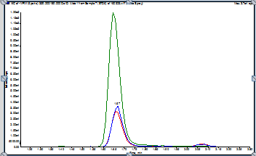
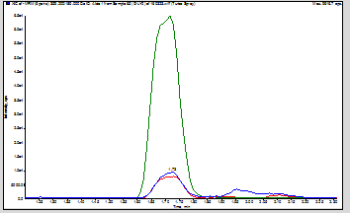
TROUBLESHOOTING POSTER TEMPLATE
PROBLEM
The SST samples at the beginning of the run look good. The start of the run – all peaks look good. Partway through the run, the peak shape has deteriorated.
TROUBLESHOOTING STEPS TAKEN
First, let’s think about it:
1)Sample Prep, LC, or Mass Spec? - Clearly it’s an LC problem!
2)Why would peak shape deteriorate? - column problem like a void in the column or particulate stuck on frit? - could it be the guard cartridge?
Now, let’s try to fix it!
-Tested the column on another LC to co nfirm the problem is the column
Backflushed column with 95:5 Acetonitrile:Water for approximately 30 minutes
-Reconnect column to original LC and inject SST samples
METHOD INFORMATION
Serum samples extracted with MtBE using Supported Liquid Extract
- Shimadzu LC/AB Sciex MSMS with MPX-2 stream LC multiplexing, problem only on one stream
- MPA: 2mM Amm Acetate in H2O
-MPB: 2mM Amm Acetate in MeOH
-100 x 3 mm, 2.6μm C18 column, with guard cartridge
-Column oven 55 °C
- 50μL injection volume
- Lots of other assays run on this system!
Figure 1: Good Chromatogram at beginning of run
Figure 2: Chromatogram with obvious peak shape issues towards end of run

